Slide 1
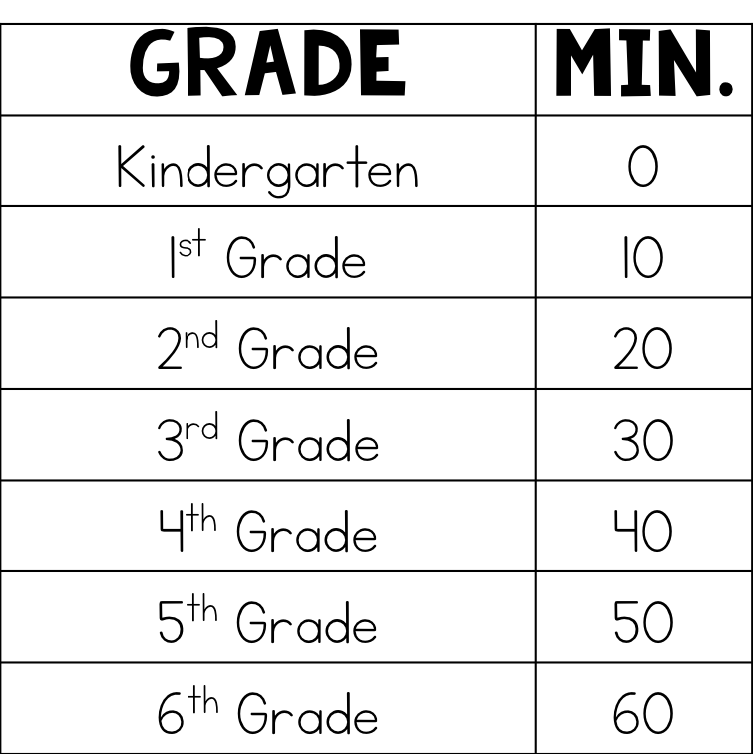
Dear Families,
As our school year begins, I’d like to introduce the homework system that will be in place this year.
Research increasingly shows that too much homework in the early grades has negative results. The recommended amount of homework for elementary students is 10 minutes per grade level; however, K-2 students (on average) receive almost 3 times this much!
In addition to too much homework, families today have increasingly less time to spend together due to busy work, school, and extracurricular schedules.
The homework overload along with the time shortage has proven to result in negative feelings toward school, family and student frustration, and a poor self image.
To combat this growing problem, our classroom will participate in Un-Homework. Un-Homework is a friendly homework alternative that offers the following:
Student Choice (Un-Homework is not graded or mandatory)
Incentives (Students are not punished for not doing homework; in fact, they earn chances for reward by choosing to do the work)
Saved Time (Choices offered are brief, hands-on, explorations that will eliminate frustration and encourage empowered learning!)
For details about this program, please see the following page. If you have questions regarding Un-Homework, please contact me! Thank you!
Each week you should expect the following homework assignments:
Read 20 minutes each night
Study math facts, phonics, and vocabulary on study guide
UN-Homework
Other written homework will be assigned on an as needed basis.

Slide 2
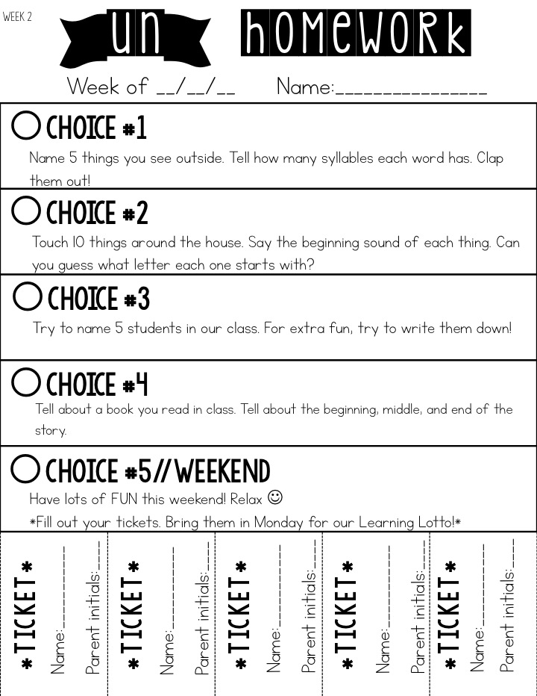
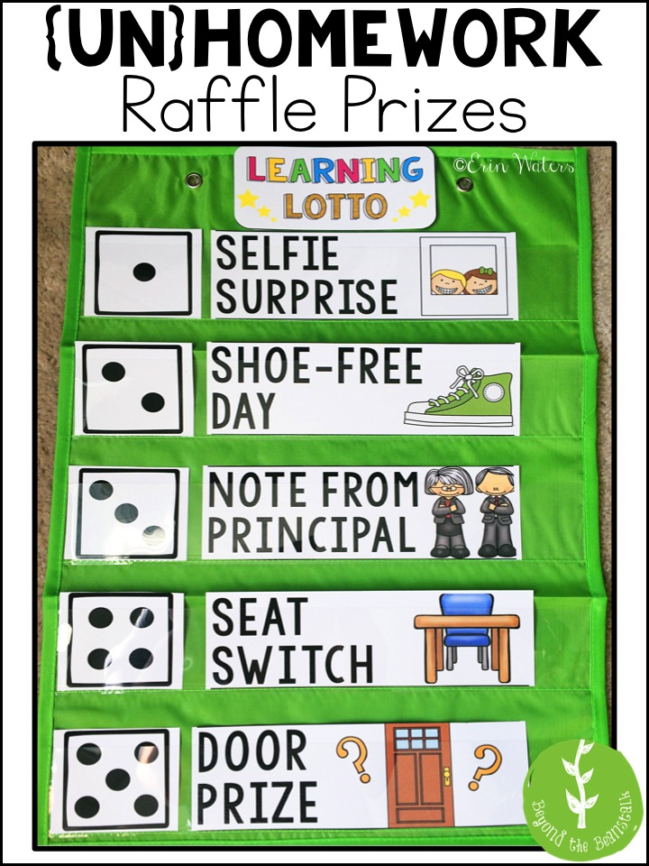
1
Students will receive 5 choices per week.
3
Students will bring in their raffle tickets by Friday every week to be entered into the Learning Lotto.
2
Students can choose 0-5 choices to complete weekly. Each time a choice is completed, he/she will fill out a raffle ticket along with parent initials.
4
A winner will be pulled each week to choose a prize.

